Slide 1
R Programming
Getting Started

Slide 2
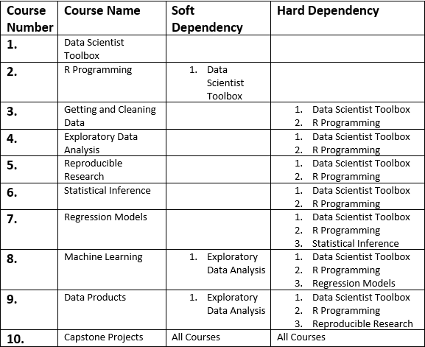
Course Dependencies
Data Science Specialization

Slide 3
Discussion Forum?

Slide 4
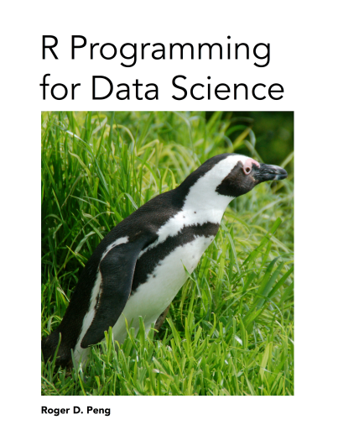
R Programming for Data Science
Textbook

Slide 5
Syllabus
Overview of R
R data types and objects
Reading and writing data
Control structures
Functions
Scoping rules
Dates and times
Loop functions
Debugging tools
Simulation
Code profiling
Course Content

Slide 6
Assignments
Programming Assignments will be posted for each topic.
SWIRL practice exercises

Slide 7
What is Swirl?

Slide 8
Requirement:
requires R 3.0.2 or later
R.version.string
Installing swirl:
install.packages(“swirl”)
Package version 2.2.21
packageVersion(“swirl”)
Loading swirl:
library(swirl)
Install the R programming Course:
install_from_swirl(“R Programming”)
Start swirl and Complete exercises:
swirl()

Slide 9
Getting Started

